Slide 1
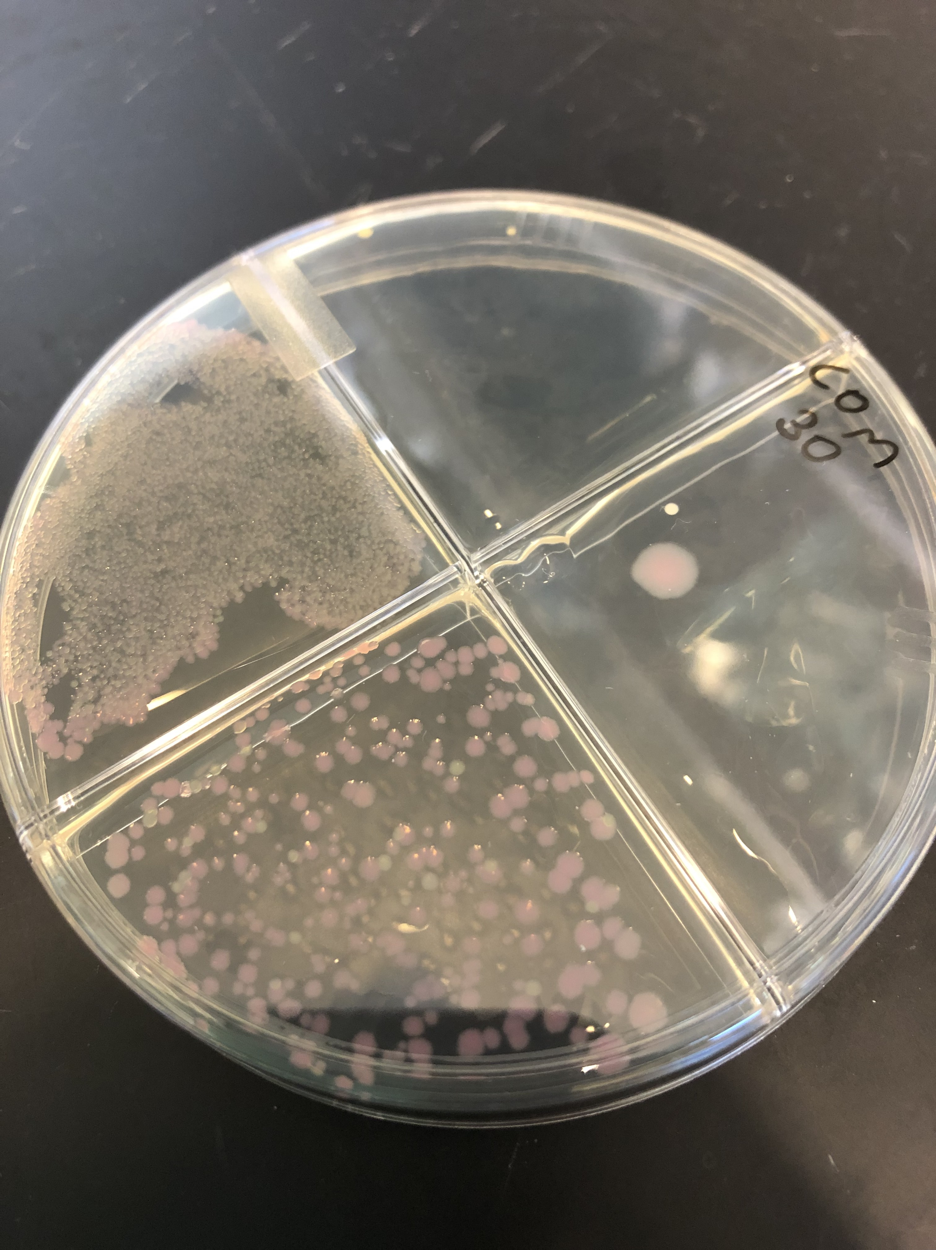
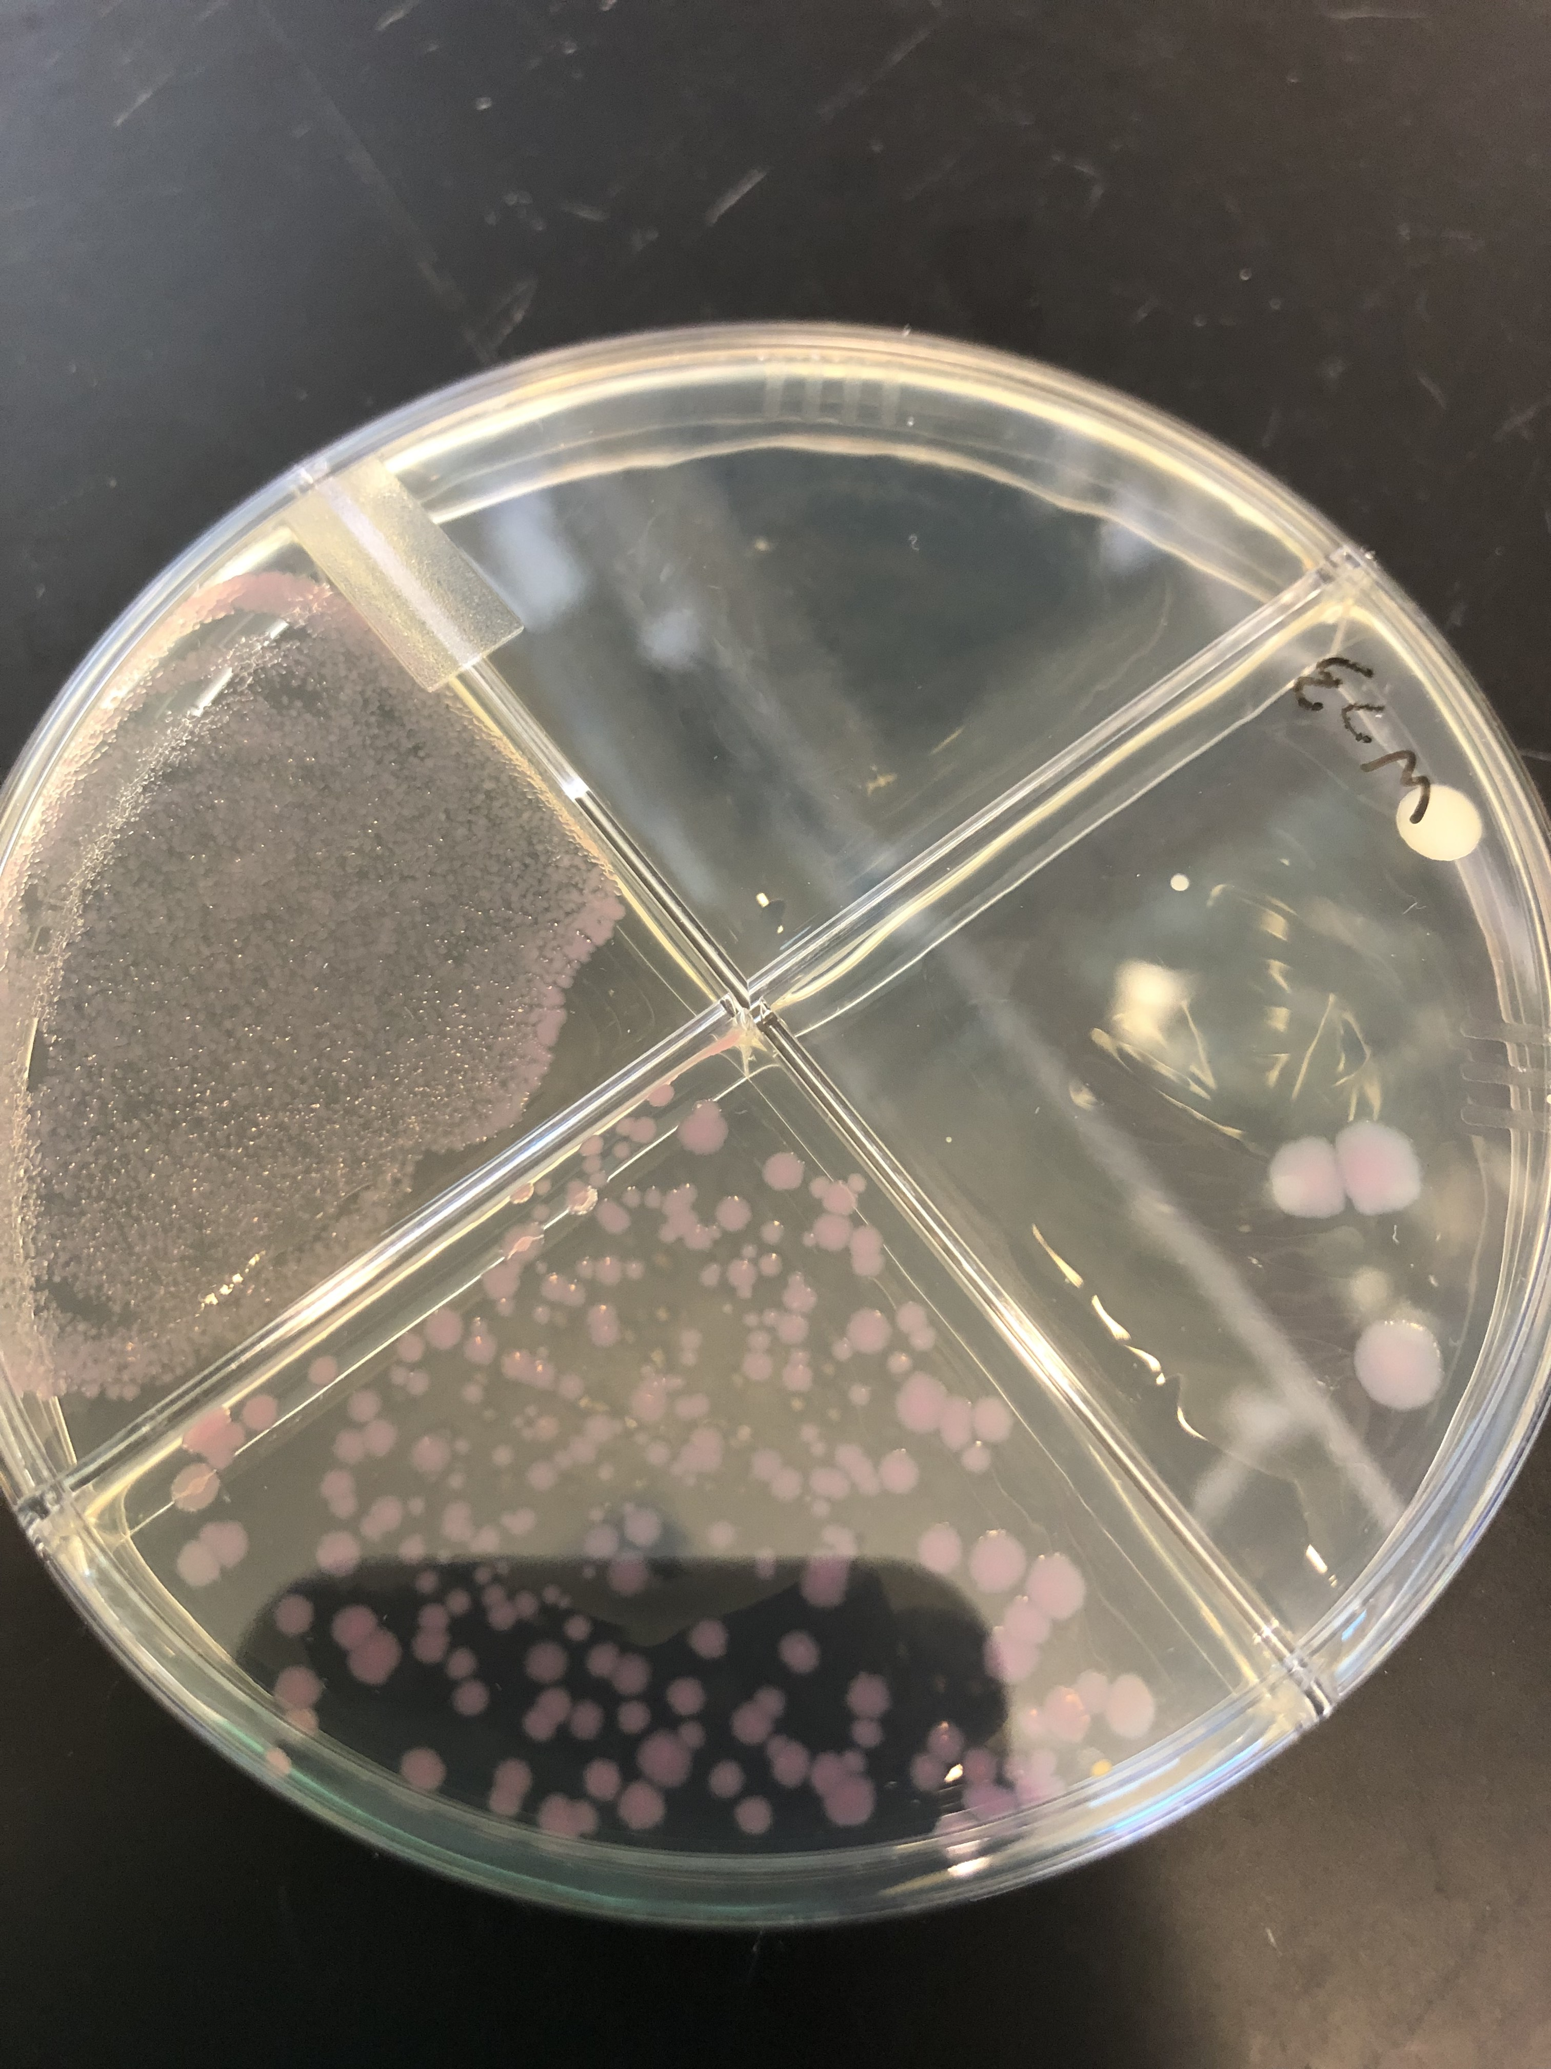
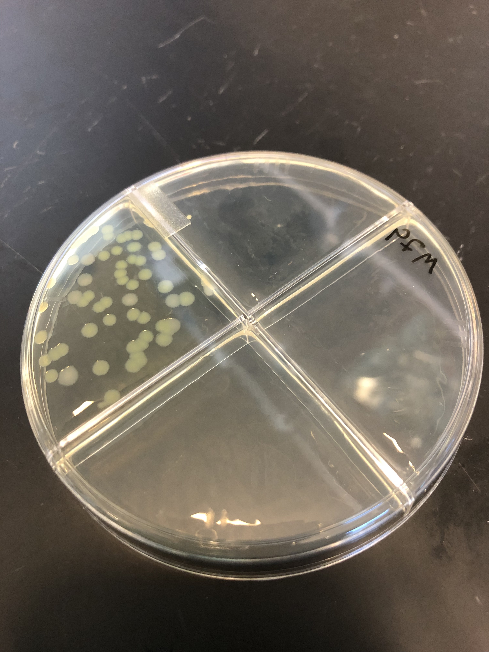
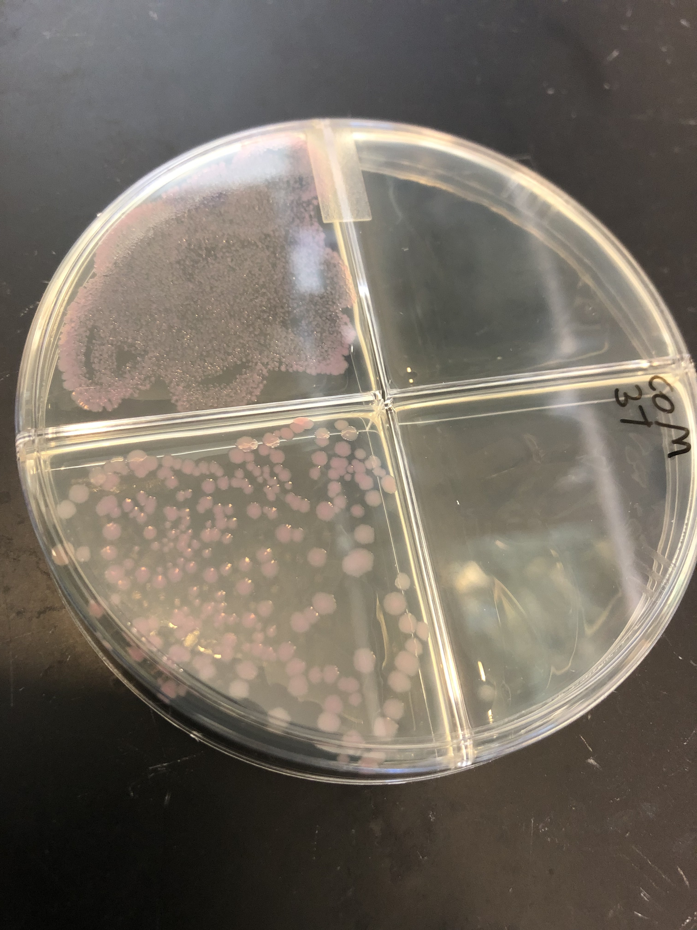
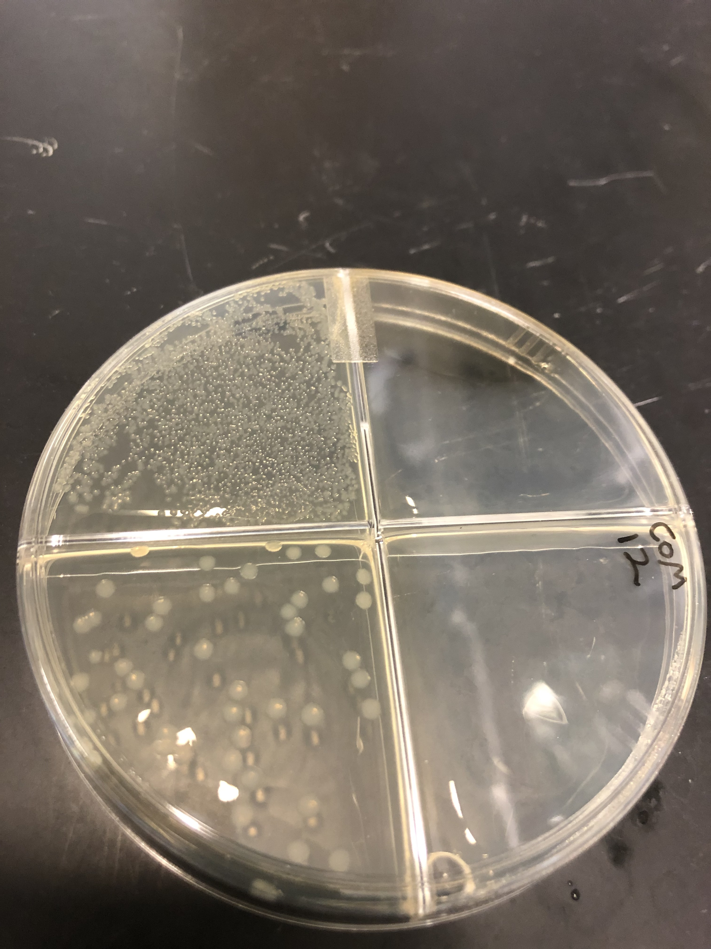
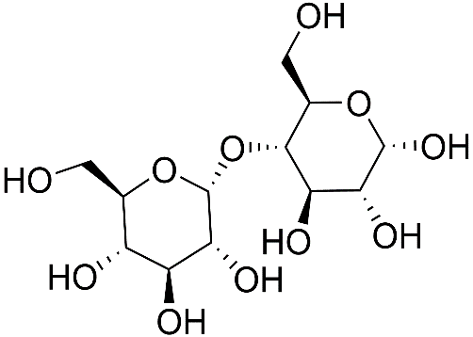
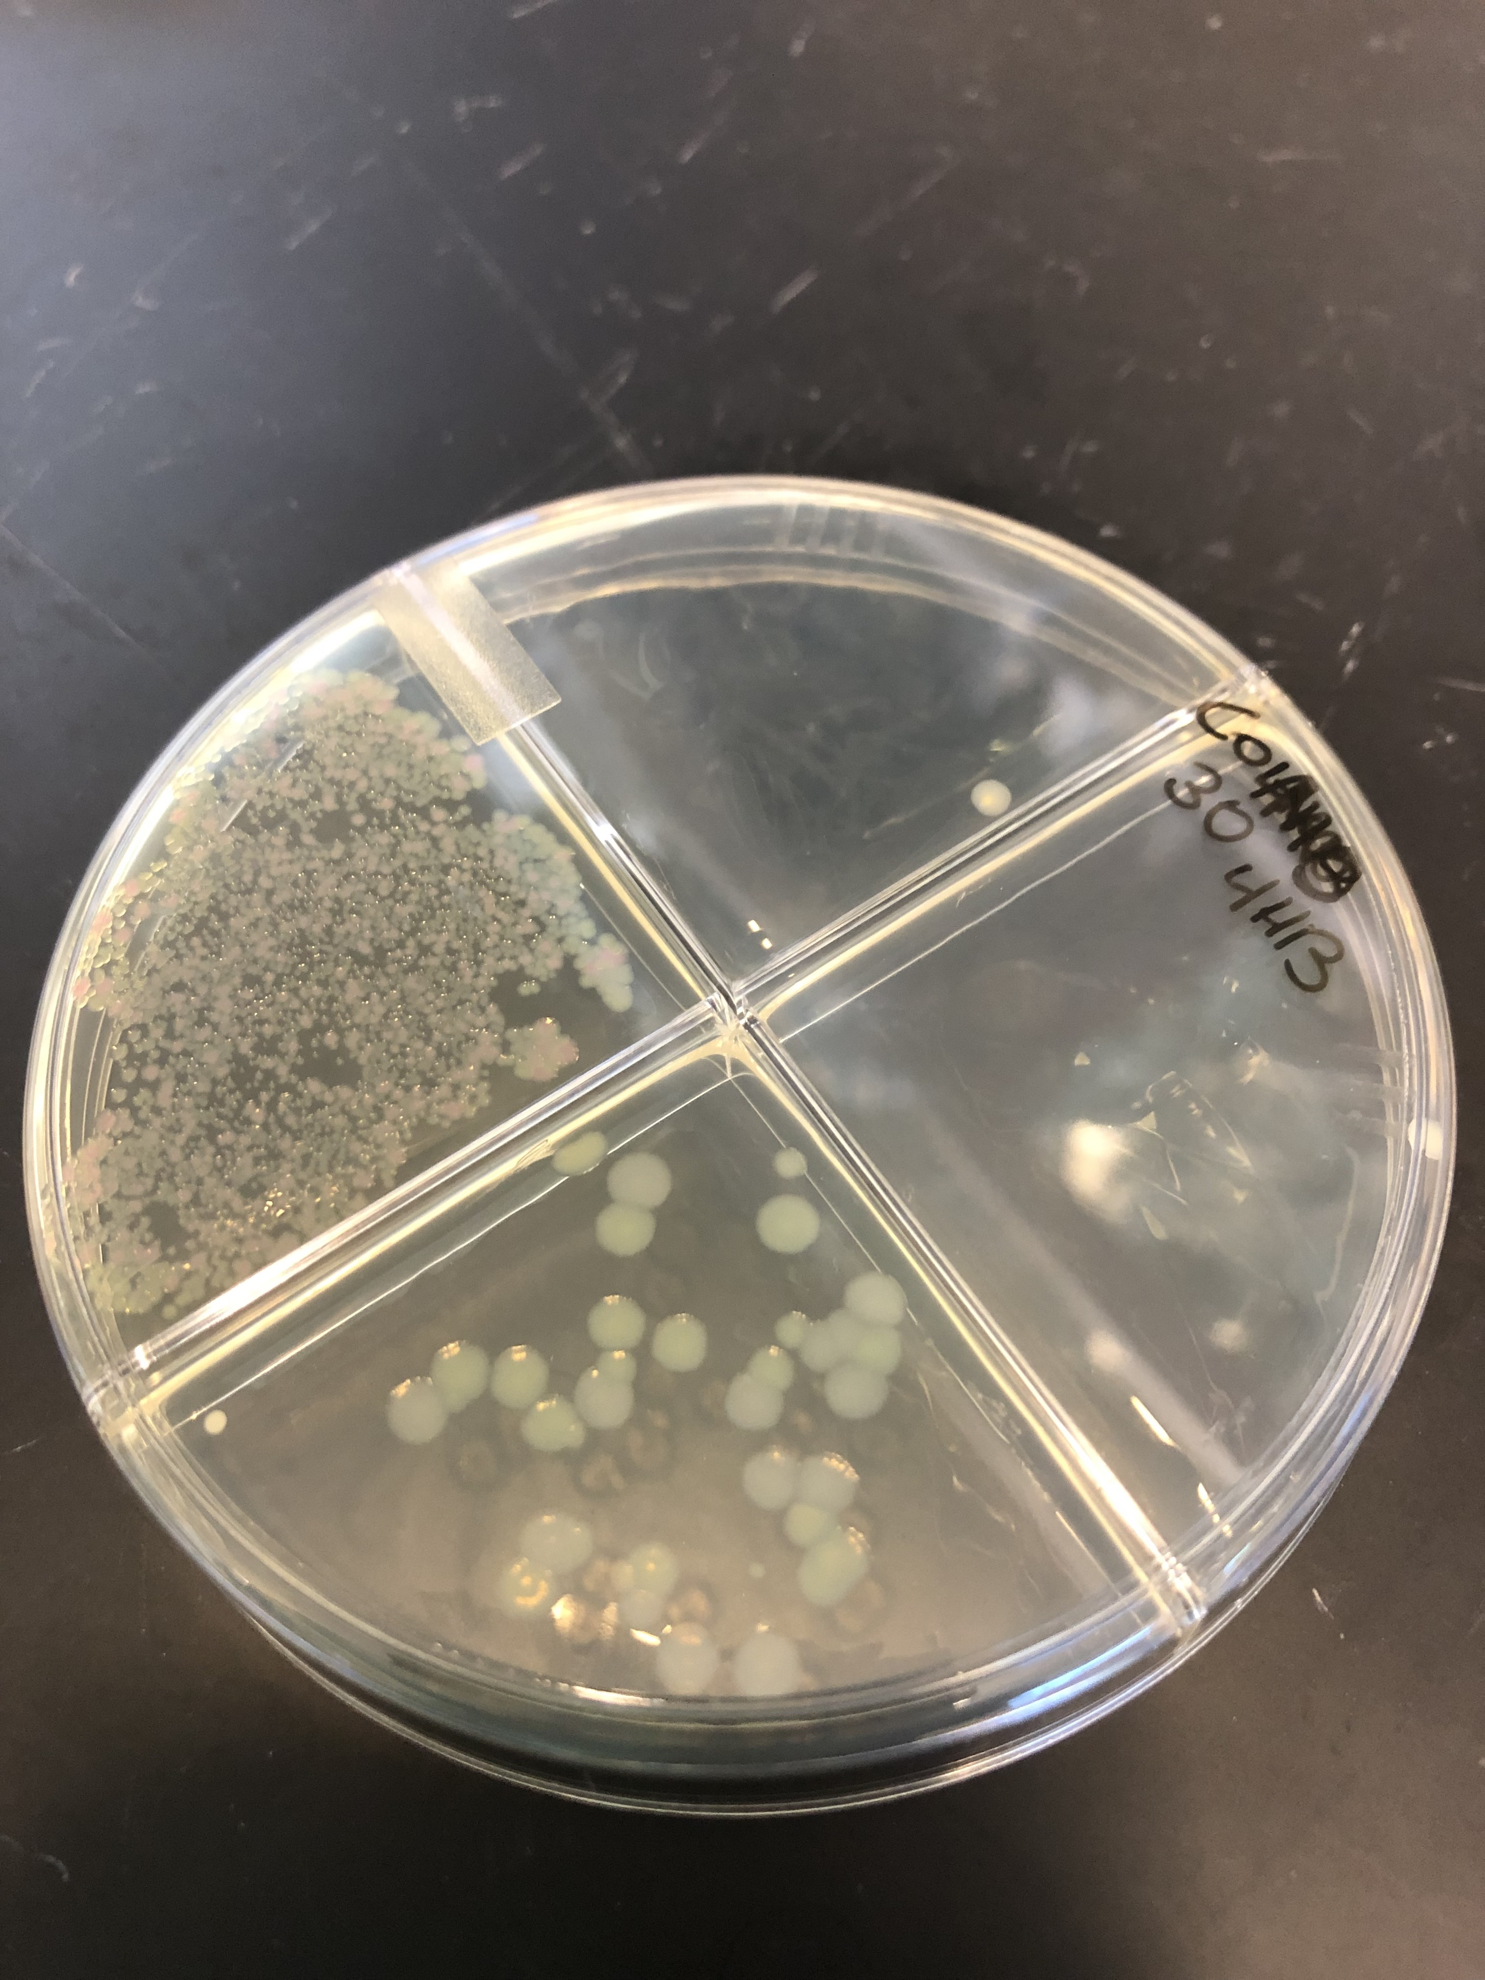
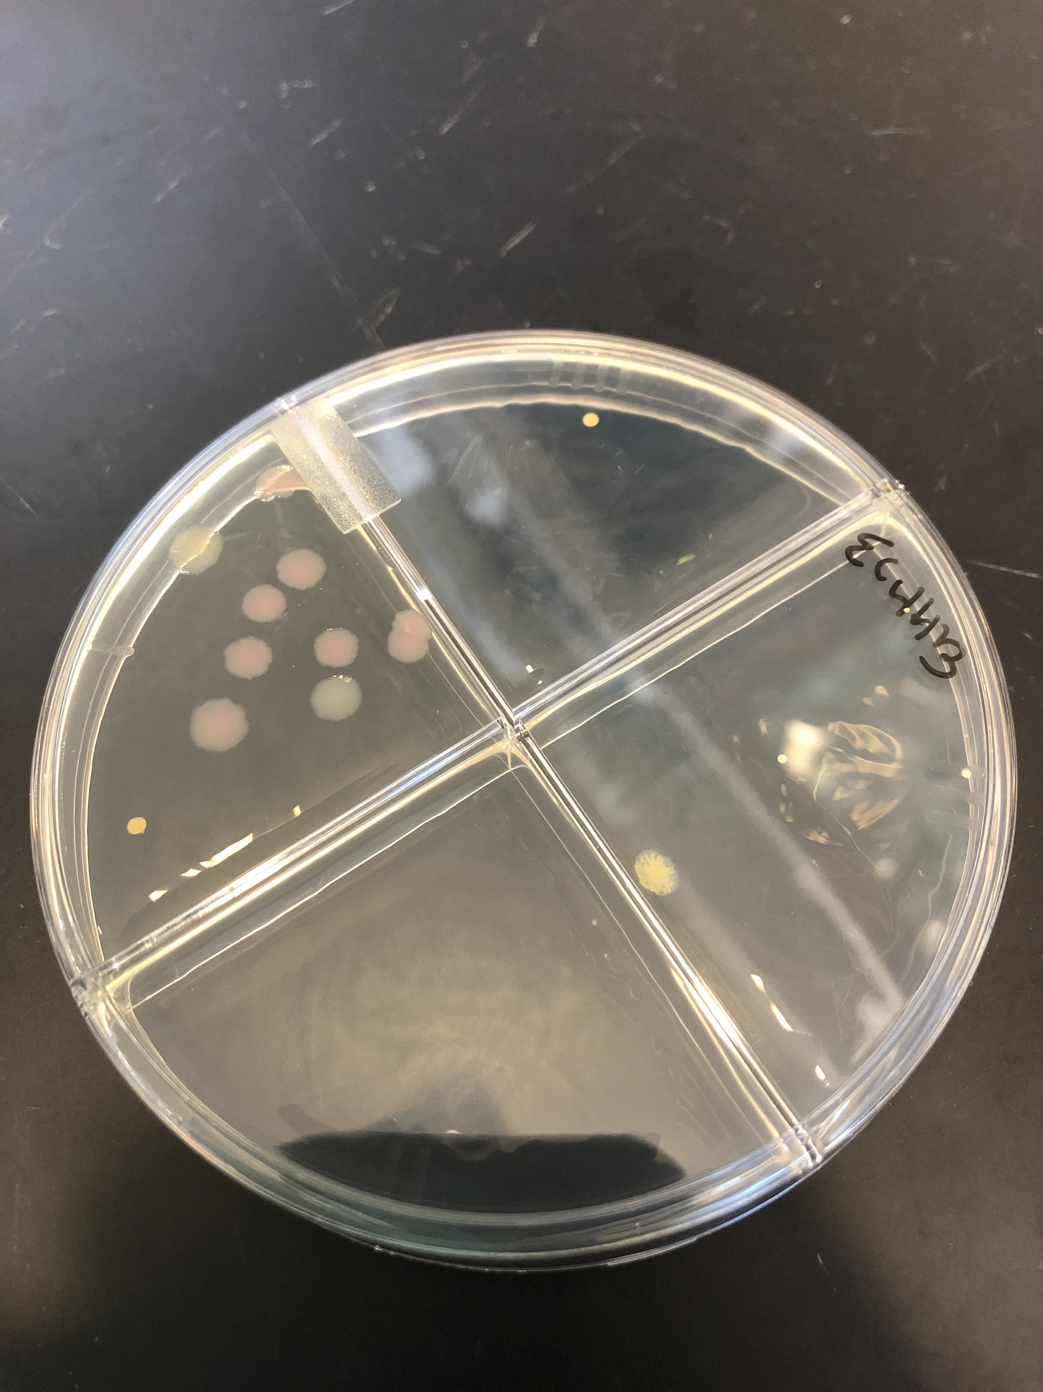
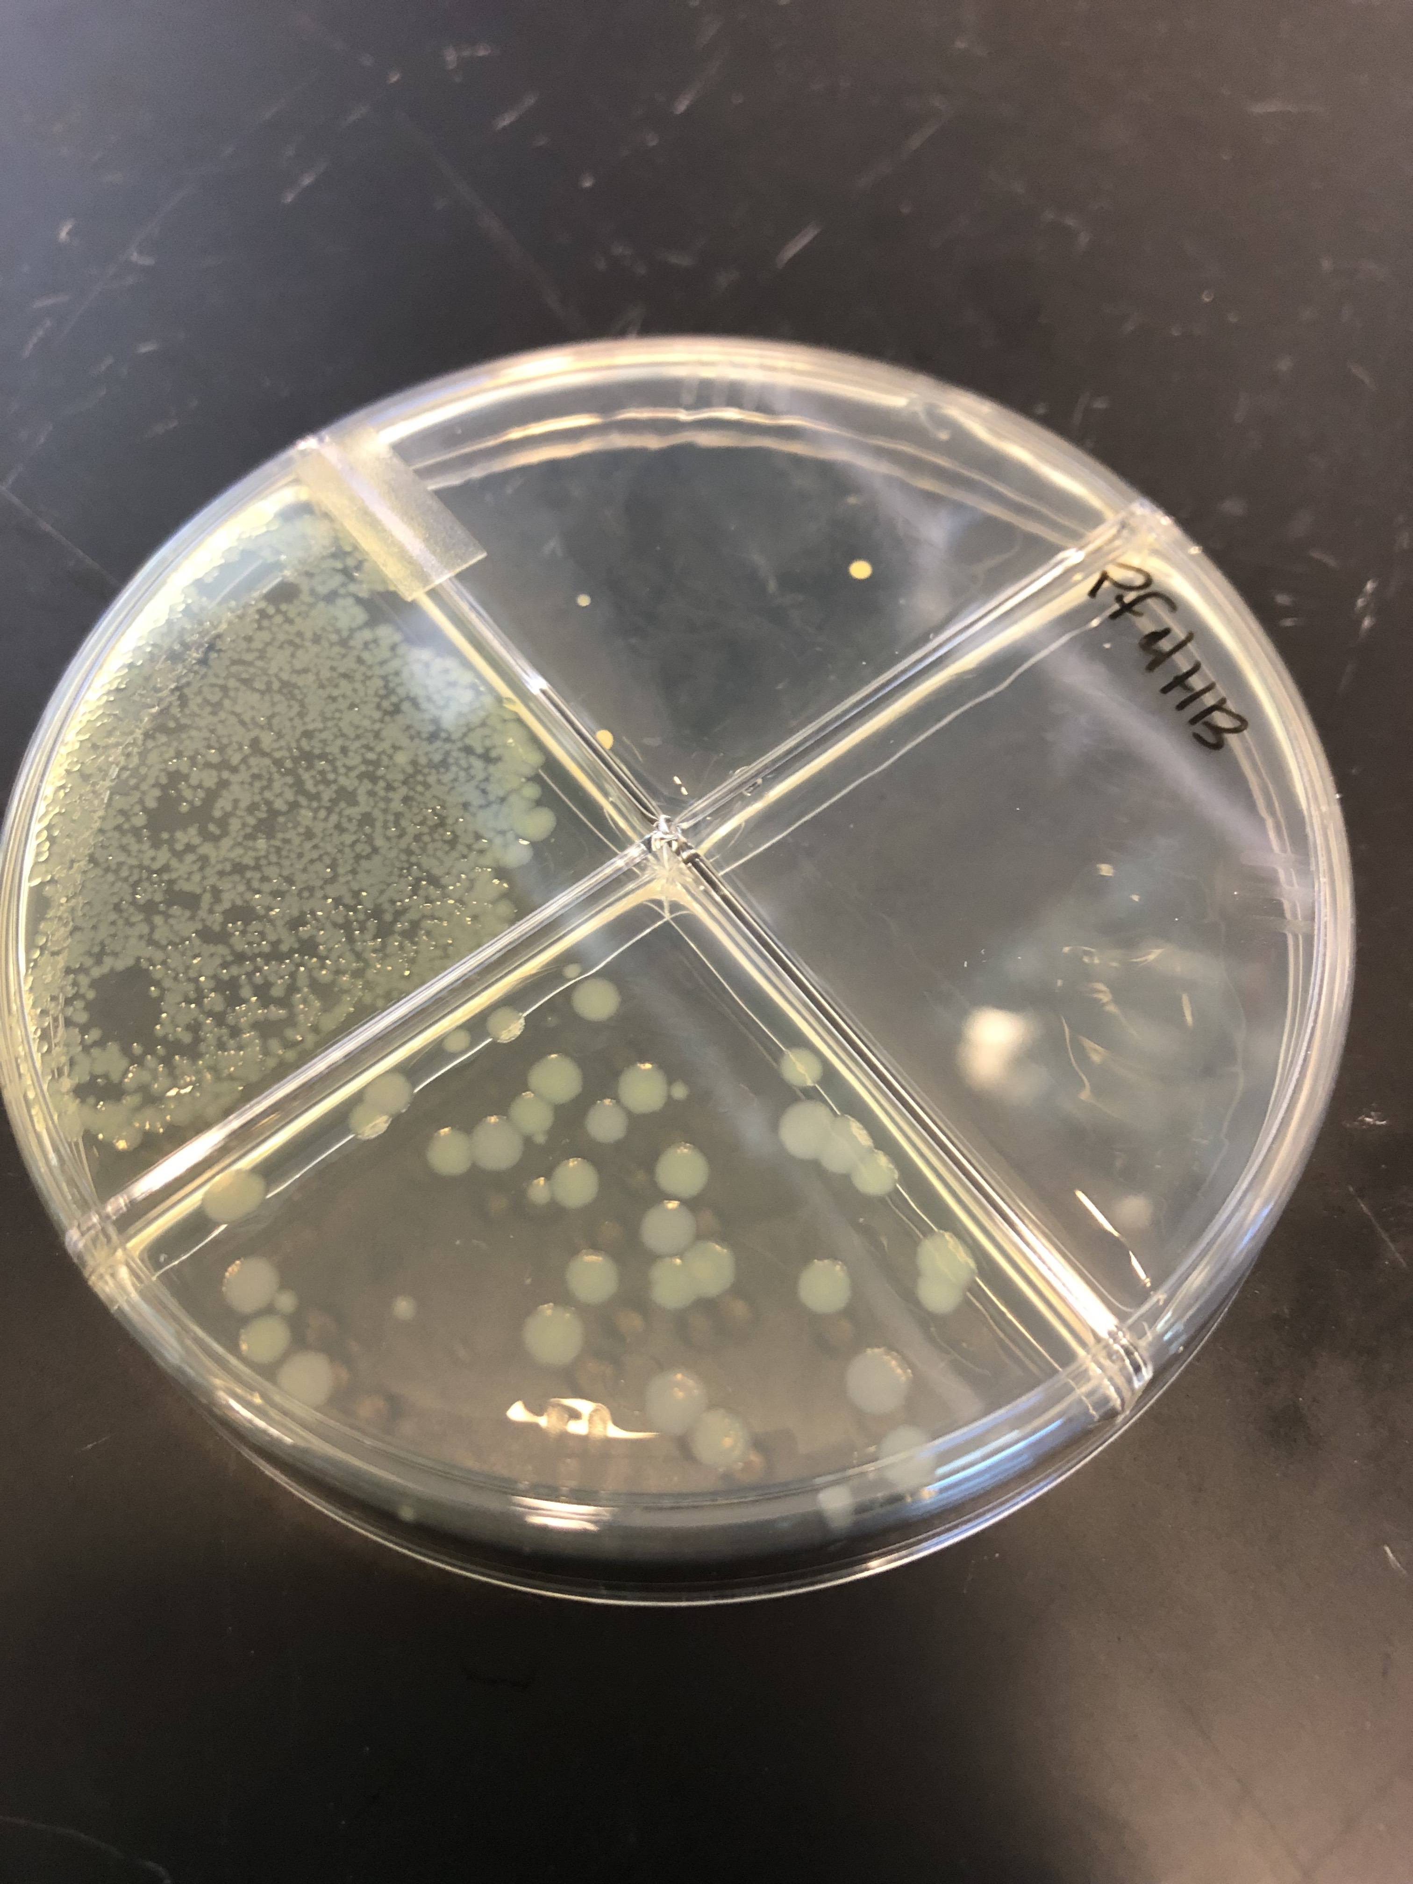
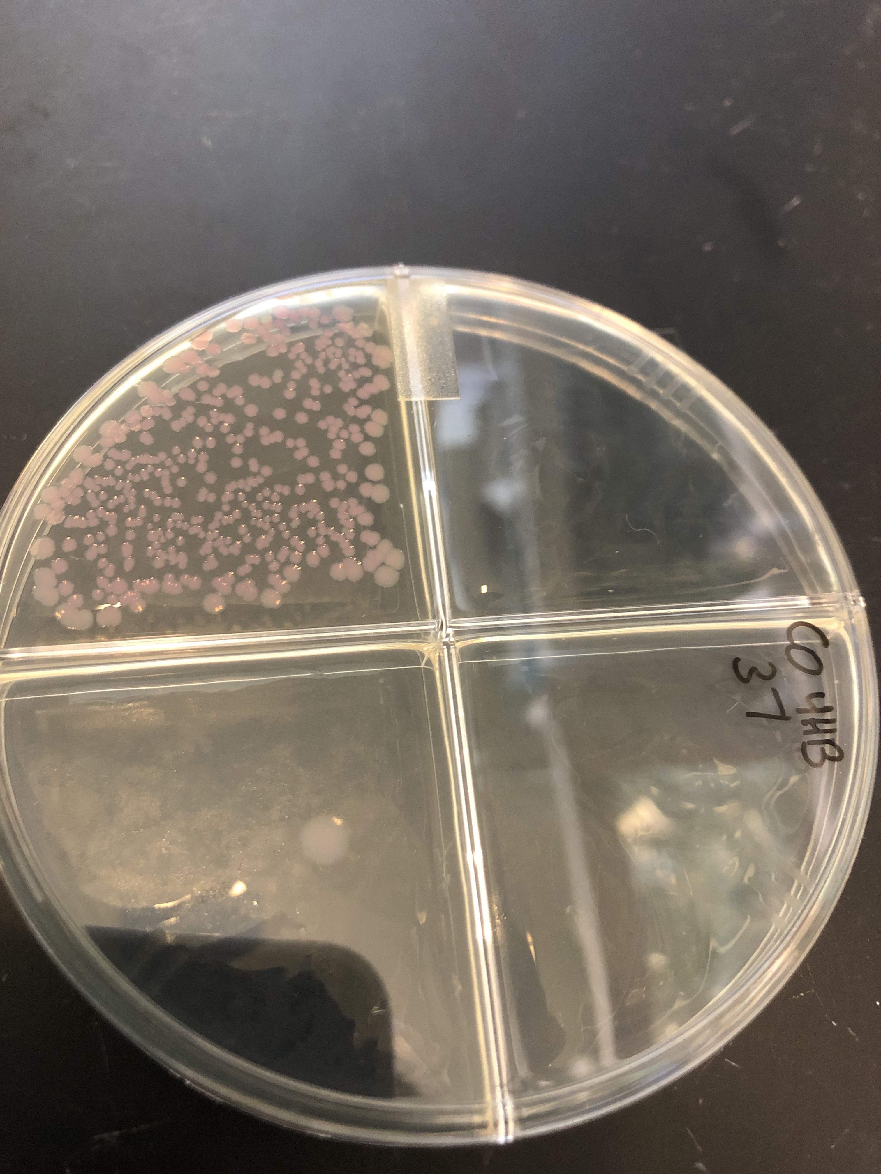
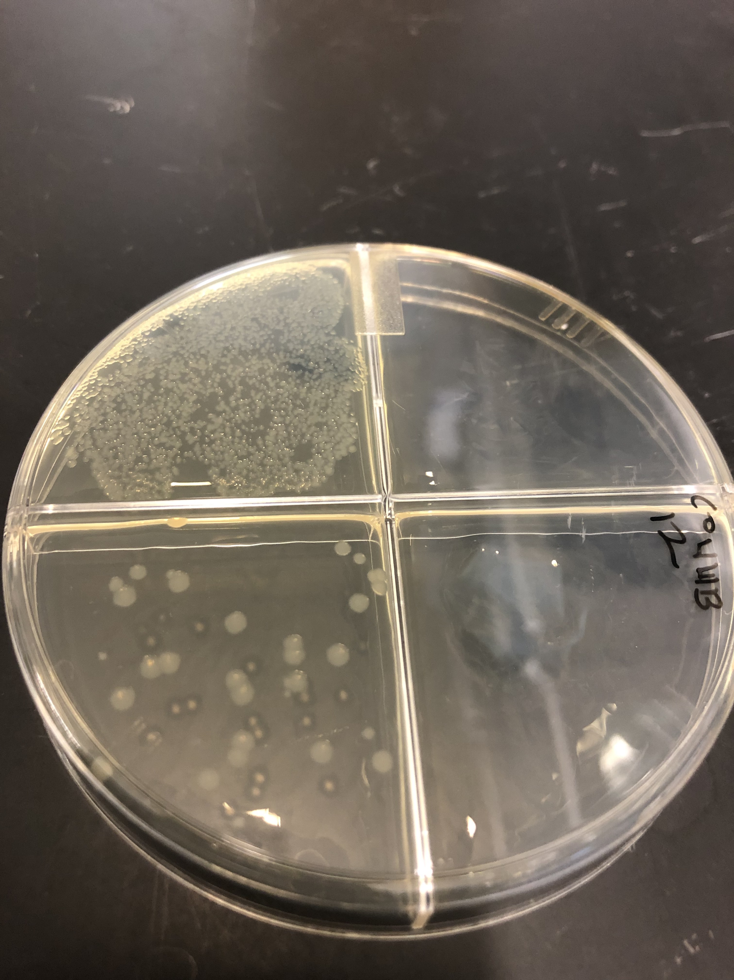
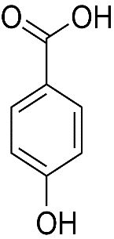
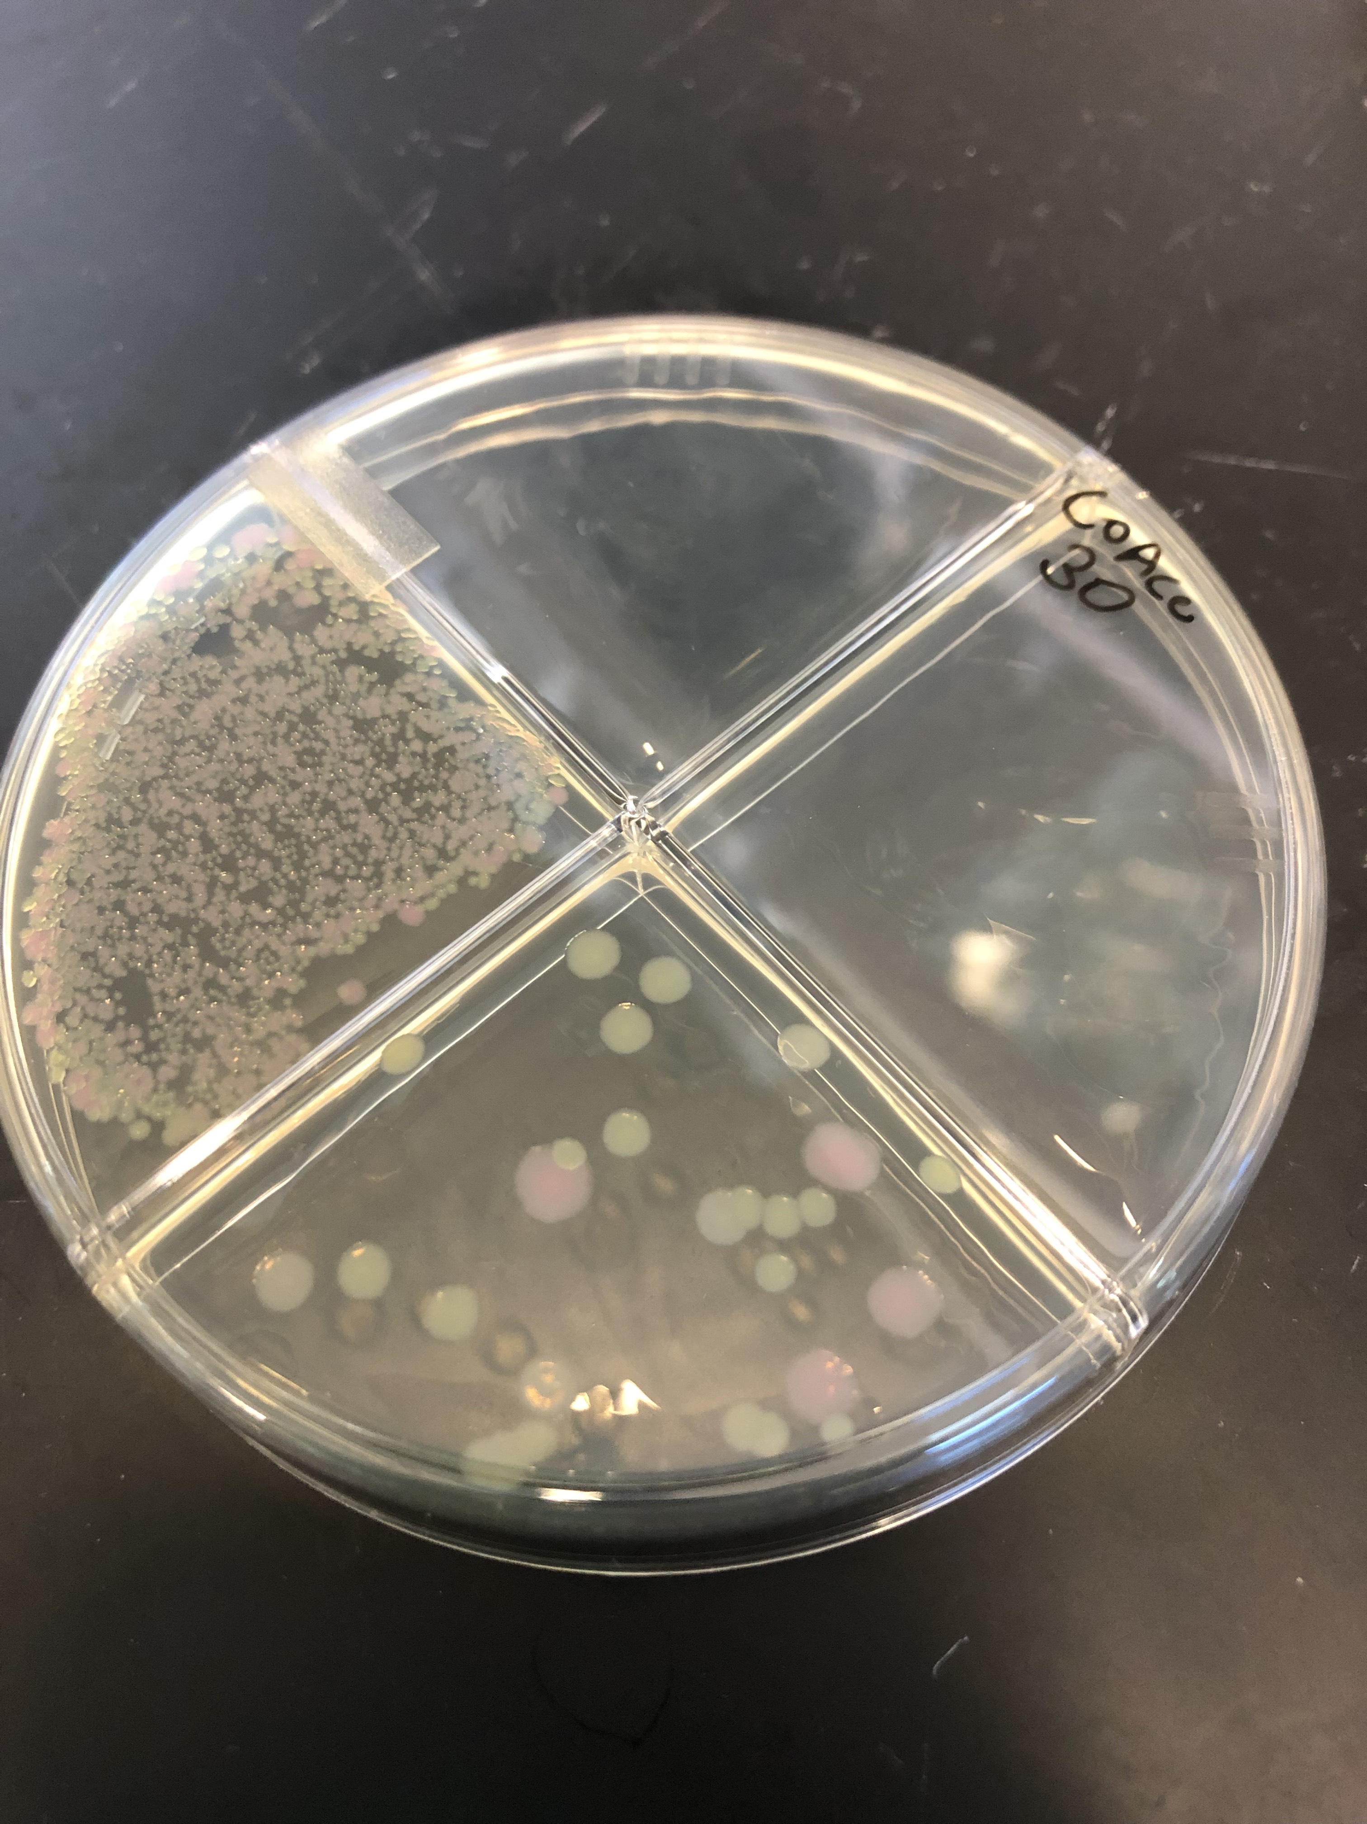
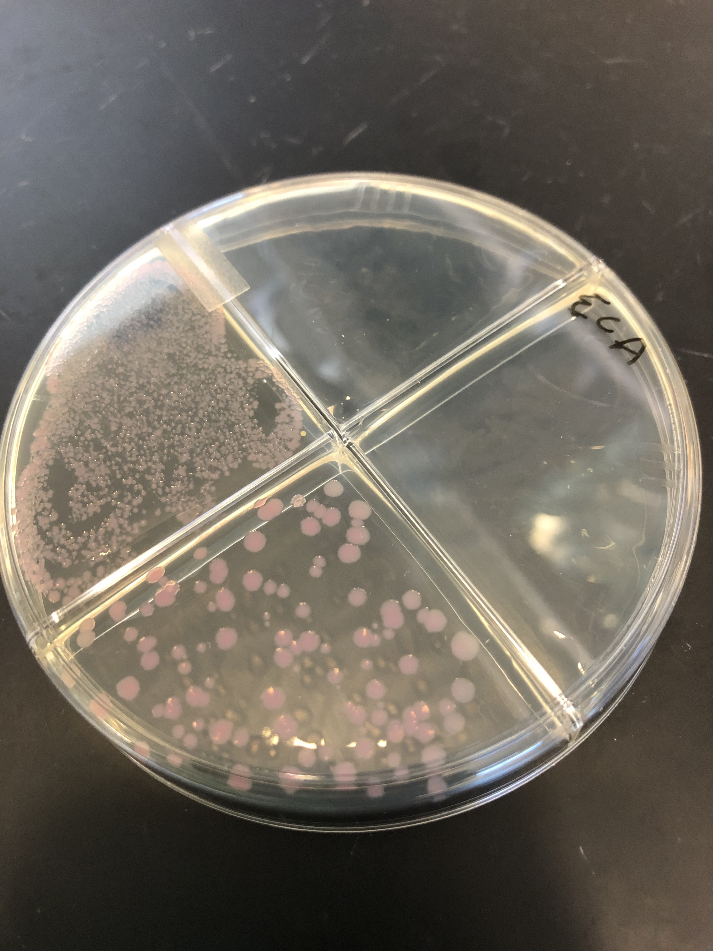
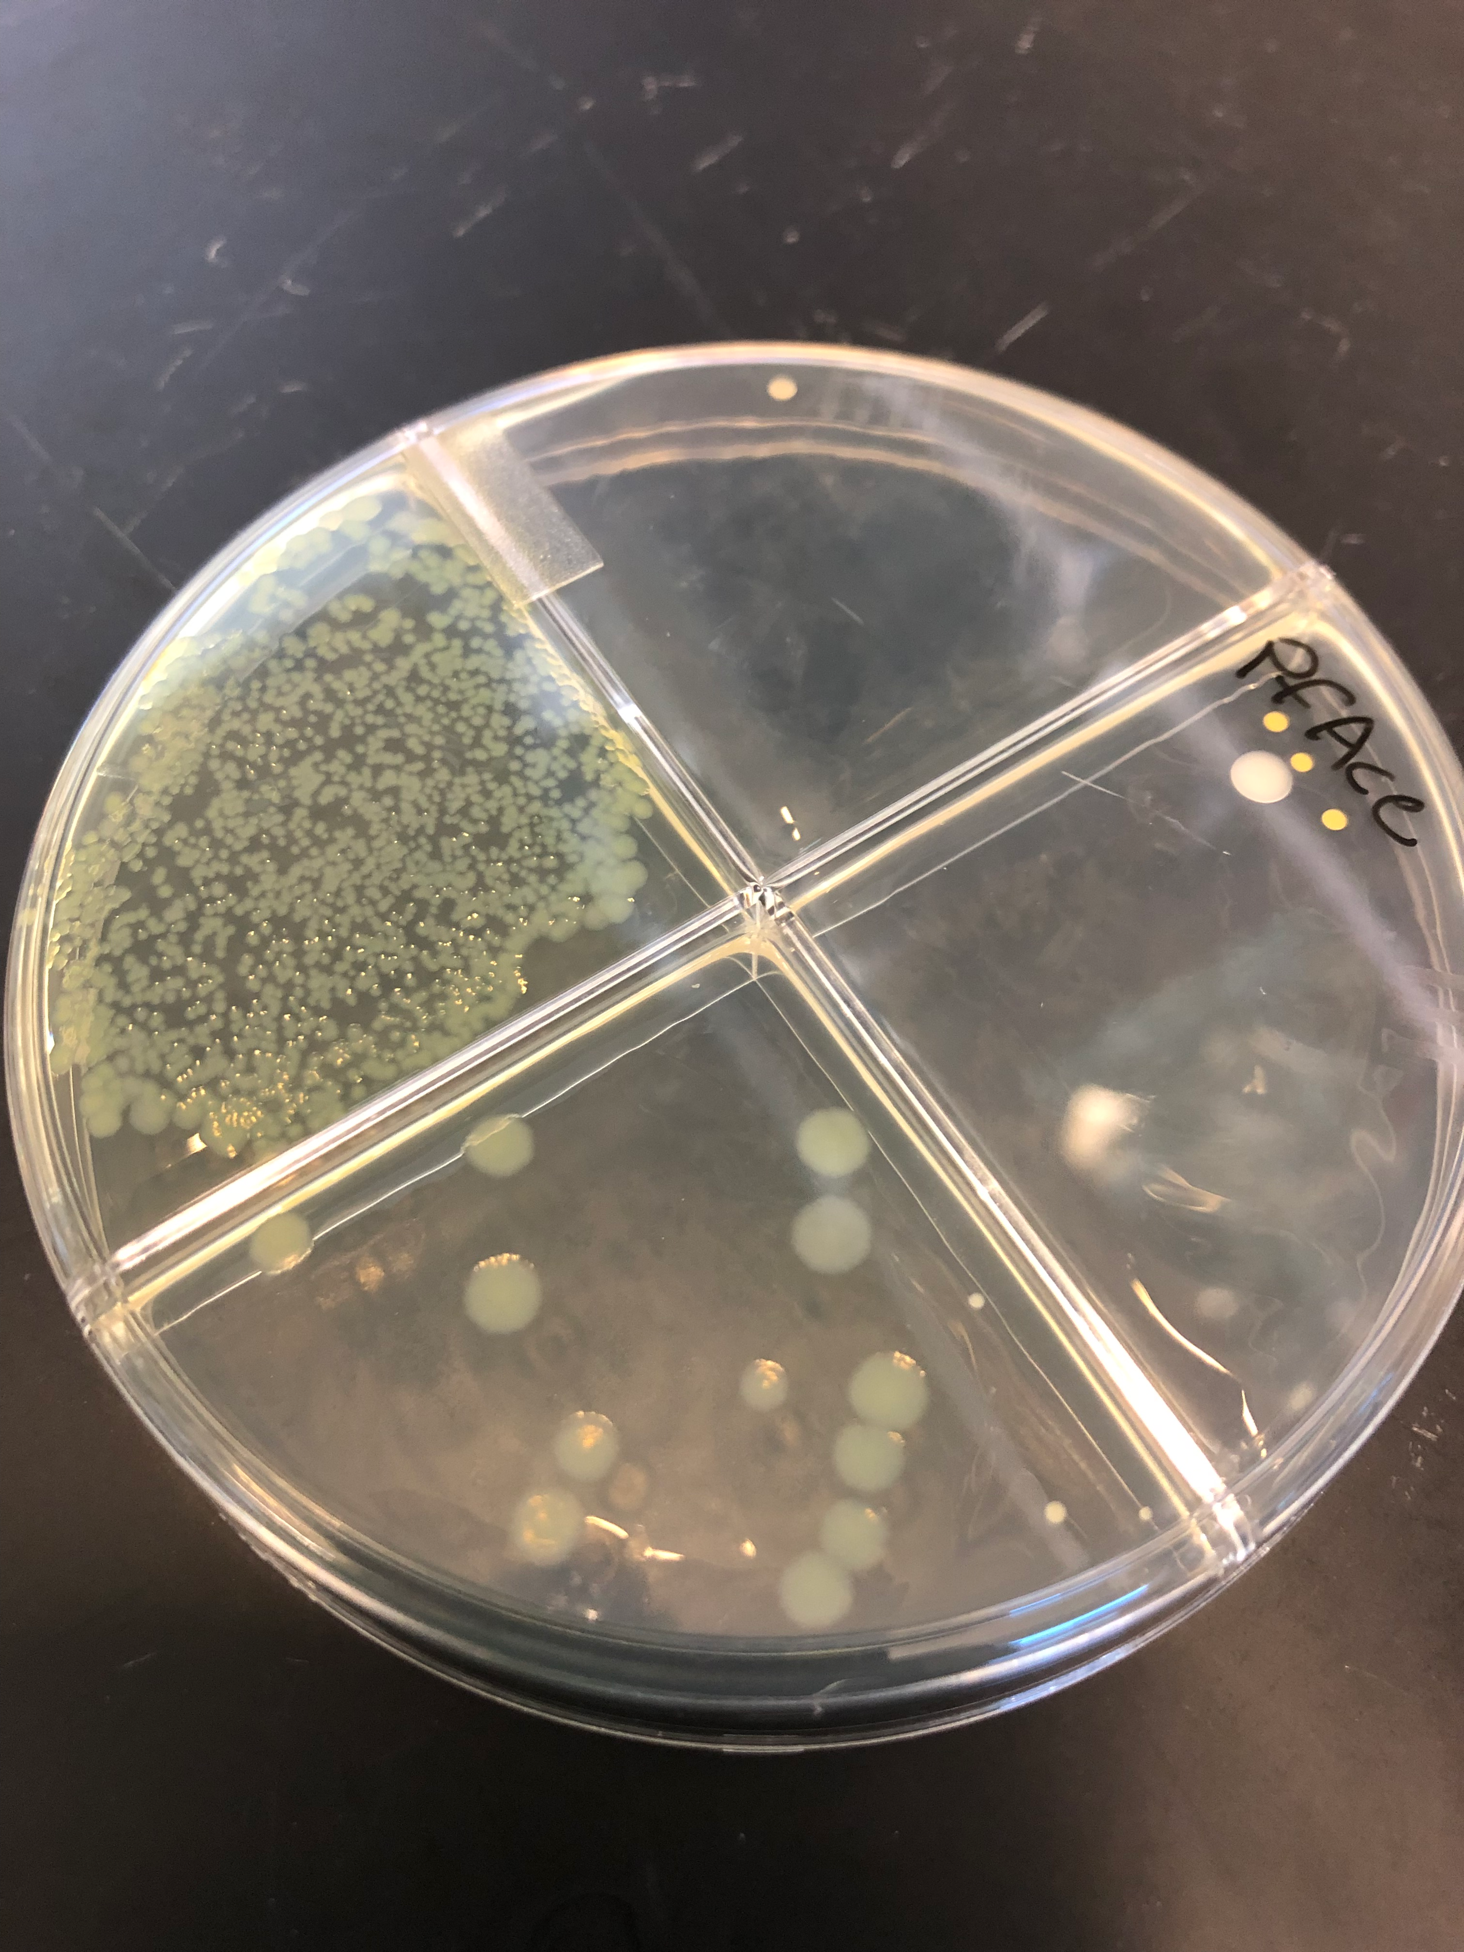
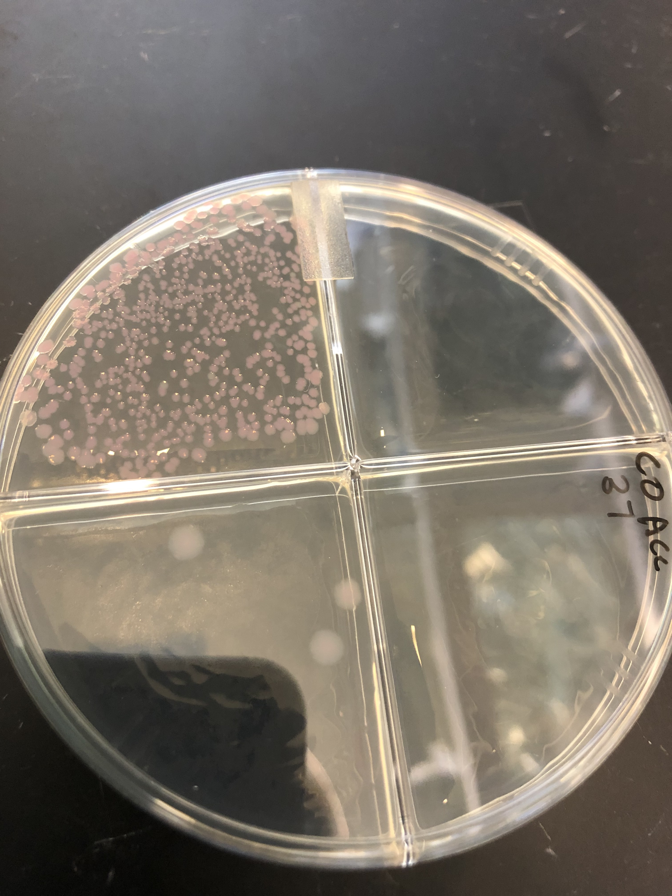
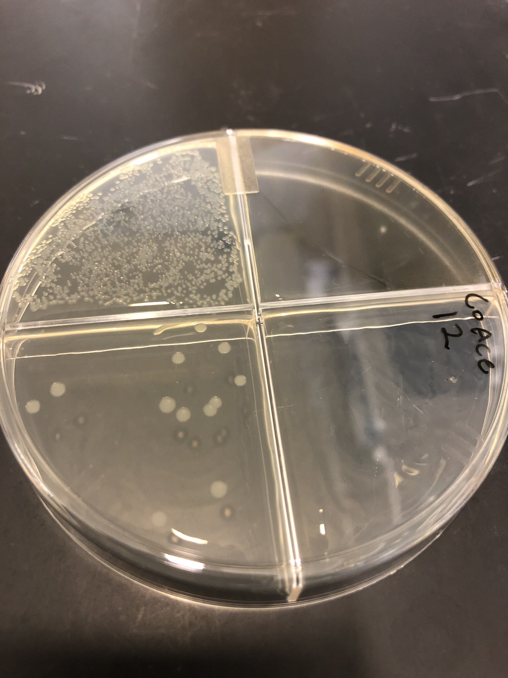
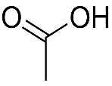
Coculture
30º plating
Coculture 37º plating
Coculture 12º plating
E. coli
P. fluorescens
Maltose
4HB
Acetate

Slide 2
Coculture
30º plating
Coculture 37º plating
Coculture 12º plating
E. coli
P. fluorescens
Maltose
REPLACE WITH CHEMICAL STRUCTURES
4HB
Acetate

Slide 3
E. coli
P. fluorescens
Maltose
4HB
Acetate
Maltose
4HB
Acetate
Coculture
30o plating
1.
1.
2.
3.
2.
3.
Maltose
4HB
Acetate
1.
2.
3.
Coculture 37o plating
Maltose
4HB
Acetate
1.
2.
3.

Slide 4
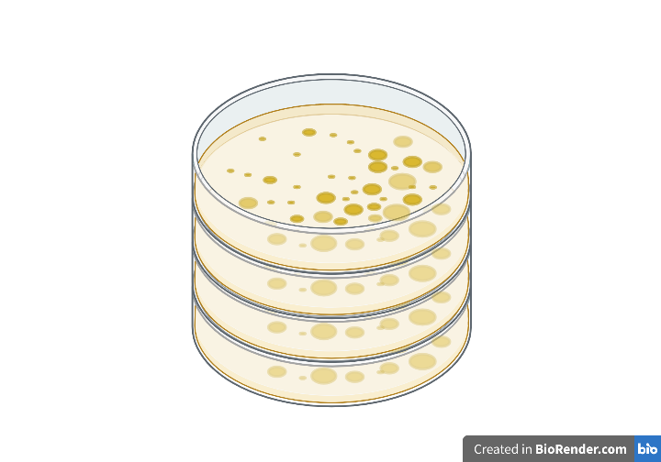
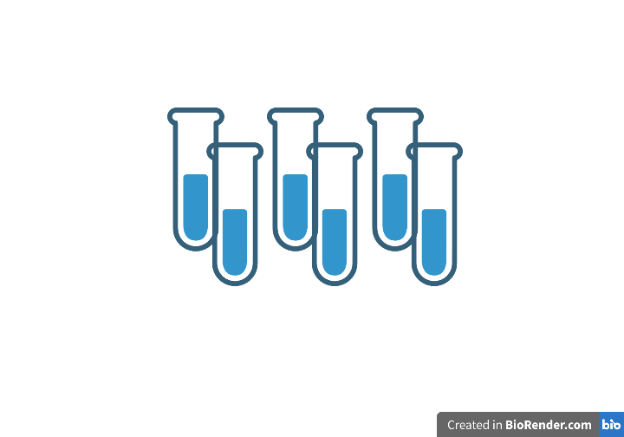
Replace names with actual chemical structures
Fluorescence- and plate- based methods
Maltose
4-HB
Acetate
37C˚
12C˚
E. coli
P. fluorescens
A two-member community consisting of P. Fluorescens and E. coli was chosen as an experimentally convenient system for several reasons. The genomes of each organism have been extensively studied. We developed two methods to accurately disentangle the composition of a liquid coculture. Finally, our research discovered significant unidirectional cross feeding from E. coli to P. fluorescens that led to interesting competitive dynamics depending on initial carbon source and organism ratio. These qualities led E. coli and P. fluorescens to be an excellent model to showcase our novel community model.

Slide 5
Metabolic modeling enabled research
Predict and rank (top 10 etc.) metabolites that are key to a microbial community’s metabolic interactions/composition
Discover new metabolic pathways/interactions by identifying molecules that should/should not be present within a community
Engineer community metabolism to exclude/include particular harmful/helpful organisms
Predict how certain stimuli (temperature, pH, toxins) may influence community composition by changing metabolite availability which in turn alters the web of metabolic interactions
CGSC methods - PoxB, AckA, Pta, and ACS knockout E. coli strains are derived from the BW25113 E. coli strain and were purchased from the Coli Genetic Stock Center (CGSC).
Thorough investigation of metabolic pathways requires multilayer omics analysis including metabolomics, proteomics, and transcriptomics. Previous omics analyses of diverse environments have produced a wealth of data on which to build models that predict organismal community dynamics from the molecular to phenotypic levels. These models allow researchers to judiciously direct limited resources towards metabolic hypotheses with the highest chance of success. One exciting component of holistic metabolic models is their ability to predict both the identities and quantities of metabolites produced and consumed by each organism. This information allows researchers to hone in on cross feeding metabolites that are produced at levels that sustain organismal growth. Models begin to identify key molecular species that enable symbiotic metabolic interactions between organisms within the vast sea of microbiomes. Moreover, metabolic models help identify metabolites that should be present, but are not, perhaps indicating previously unaccounted for metabolic cross feeding or inhibition is taking place within the microbial community.
E. coli and P. fluorescens were chosen for several reasons. Firstly they are model organisms that cover a wide range of disciplines including the human microbiome, bioproduction, synthetic biology, the rhizosphere, agriculture, and ecology. Secondly, the genomes and metabolic profiles of each organism have been studied extensively, enabling robust validation of metabolic models. Finally, these two organisms have never been studied as a coculture, leaving little opportunity for preconceived biases to guide model and hypothesis development.

Slide 6
Replace names with actual chemical structures
Maltose
4-HB
Fluorescence- and plate- based methods
Extra notes:
We were able to precisely quantify each organism within a liquid coculture via two experimental methods, 1. fluorescence measurements and 2. temperature selective growth. E. coli were labeled with a red fluorescent protein while P. fluorescens were labeled with a green fluorescent protein via a transformed plasmid. By measuring both red and green fluorescence along with optical density we were able to approximate which biomass changes were due to E. coli or P. fluorescens over time.
Fluorescence can be difficult to calibrate due to changes in fluorescent protein expression under different growth conditions or states. To validate our fluorescent reporters we developed a temperature dependent growth assay based on each organism’s inherent physiology. E. coli grows at 37 degrees Celsius whereas P. fluorescens cannot, and P. fluorescens grows at 12 degrees Celsius whereas E. coli cannot. By incubating coculture samples at each temperature we were able to determine the exact ratio and quantity of each organism and validate the accuracy of fluorescence measurements. The green protein signal grows proportionally with P. fluorescens, but red protein signal suddenly increases when E. coli reach their stationary growth phase.
Acetate
E. coli
P. fluorescens
37C˚
12C˚
A two-member community consisting of P. Fluorescens and E. coli was chosen as an experimentally convenient system for several reasons. The genomes of each organism have been extensively studied. We developed two methods to accurately disentangle the composition of a liquid coculture. Finally, our research discovered significant unidirectional cross feeding from E. coli to P. fluorescens that led to interesting competitive dynamics depending on initial carbon source and organism ratio. These qualities led E. coli and P. fluorescens to be an excellent model to showcase our novel community model.

Slide 7
E. coli
P. fluorescens
Maltose
4HB
Acetate
Maltose
4HB
Acetate
1.
1.
2.
3.
2.
3.
Coculture
30o plating
Coculture 37o plating
Maltose
4HB
Acetate
Maltose
4HB
Acetate
1.
1.
2.
3.
2.
3.

Slide 8
E. coli
Maltose
4HB
Acetate
1.
Coculture
30o plating
2.
3.
Maltose
4HB
Acetate
1.
2.
3.
Coculture 37o plating
Maltose
4HB
Acetate
1.
2.
3.

Slide 9
Co 4HB 37
Co Acetate 37
PF 4HB
PF Acetate
PF Maltose
Co Maltose 37
Co Acetate 30
EC 4HB
EC Acetate
EC Maltose
Co 4HB 30
Co Maltose 30

Slide 10
PF 4HB
PF Acetate
PF Maltose
Co 4HB 37
Co Acetate 37
Co Maltose 37
Co = Coculture
Monocultures
Co Maltose 30
EC 4HB
EC Acetate
EC Maltose
Co 4HB 30
Co Acetate 30

Slide 11
Co 4HB 37
Co Acetate 37
Co Maltose 37
PF 4HB
PF Acetate
PF Maltose
Co Acetate 30
EC 4HB
EC Acetate
EC Maltose
Co 4HB 30
Co Maltose 30

